Slide 1

Course Code: MATH 211
Course Title: MATH III
Lecture 1 (Laplace Transform)
Tazin Tamanna
Lecturer in Mathematics
Department of Science and Humanities
M.Sc. in Applied Mathematics (KU)
B.Sc. in Mathematics (KU)

Slide 2
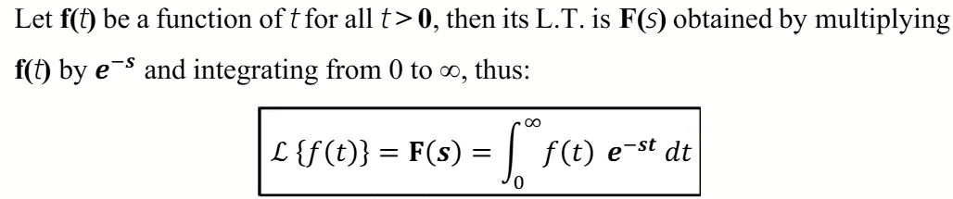
Laplace Transform
‘s’ is a parameter which may be real or complex number.
Laplace Transform
Lecture Division on Laplace Transform
Inverse Laplace Transform
Application of Laplace Transform (ODE Solution)

Slide 3
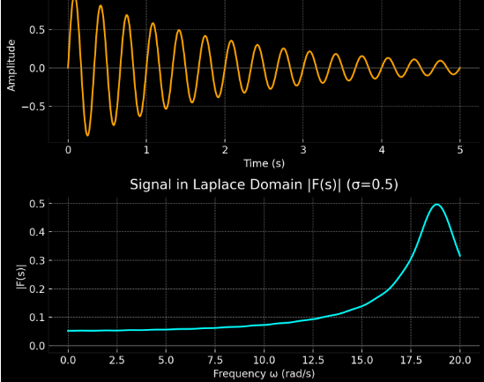
Why Do We Need Laplace Transform?
Probability → Compute statistical moments.
Control Systems → Transfer functions, stability, system response.
Laplace Transform
Heat/Fluid PDEs → Solve diffusion
& conduction problems.
Mechanical Systems → Analyze vibrations
& damping.
Signal Processing → Filter and system design.
Communications → Transmission,
bandwidth, filter design.
The Laplace Transform converts a problem from the time domain (t-domain) to the complex frequency domain (s-domain). In the time domain, systems are described by differential equations, which are often difficult to solve. By moving to the s-domain, these differential equations become algebraic equations, which are much easier to handle.

Slide 4
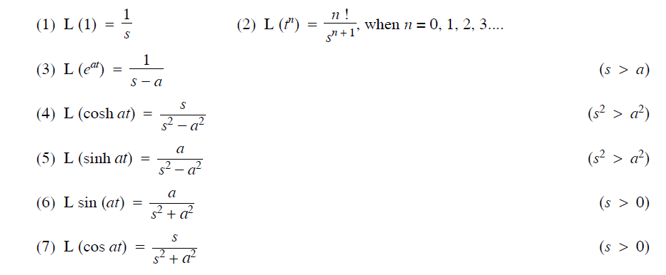
Module I: Laplace Transform of Some Elementary Functions

Slide 5

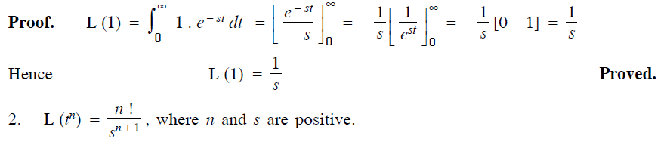
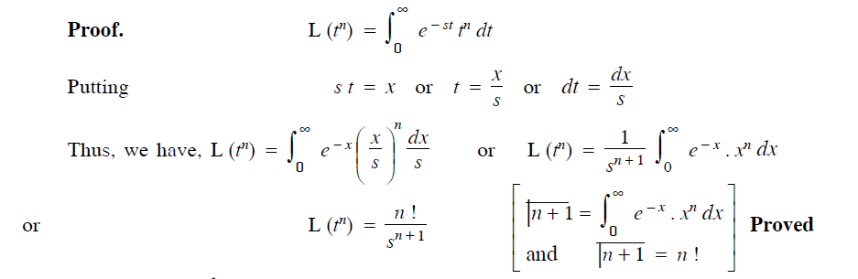

Slide 6
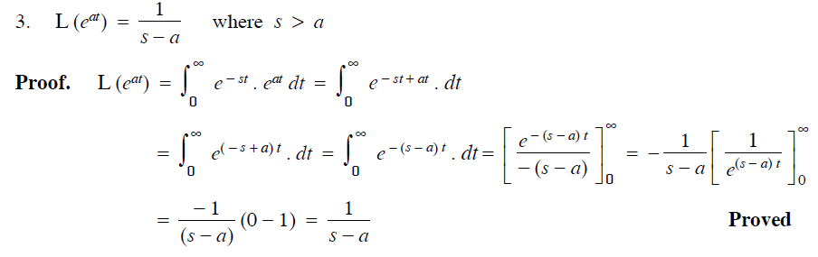

Slide 7
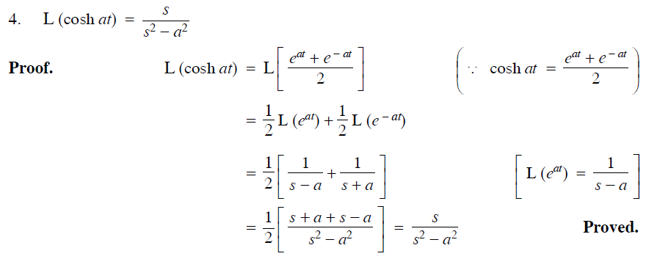

Slide 8
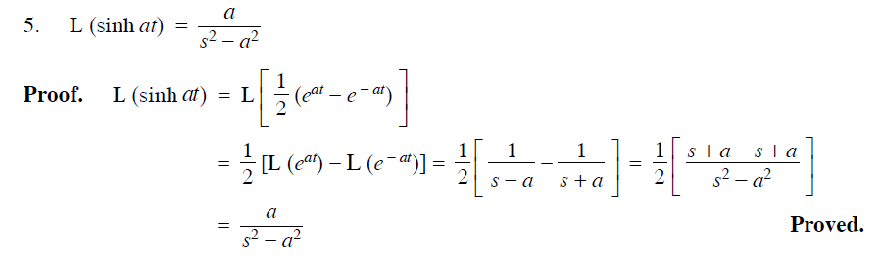
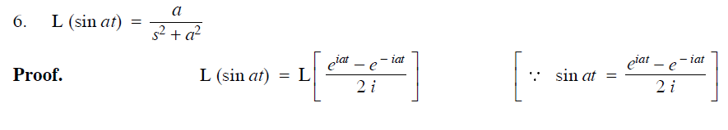

Slide 9
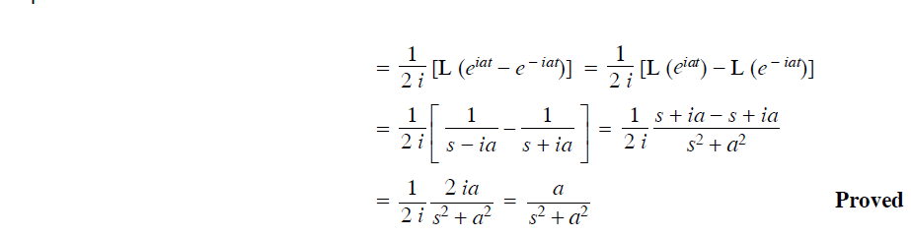
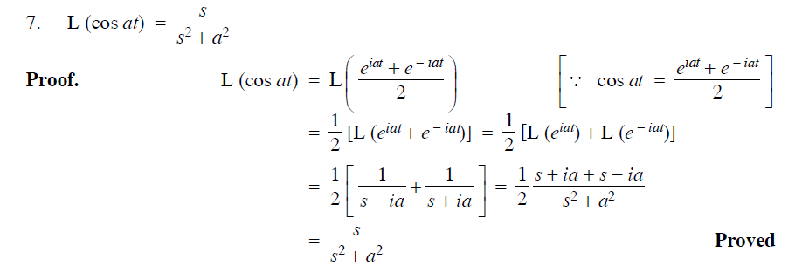

Slide 10
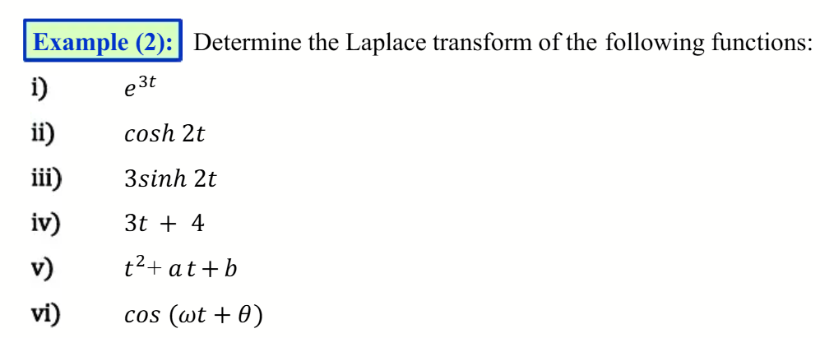
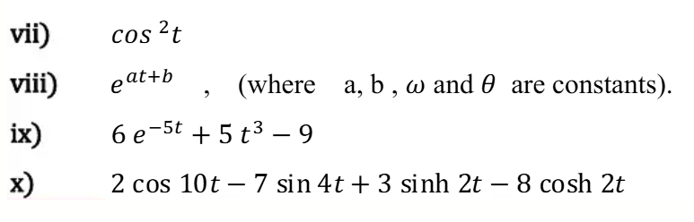

Slide 11
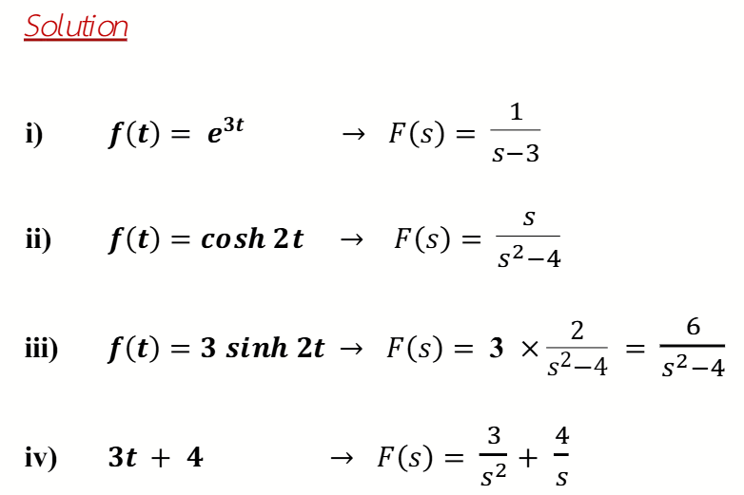


Slide 12
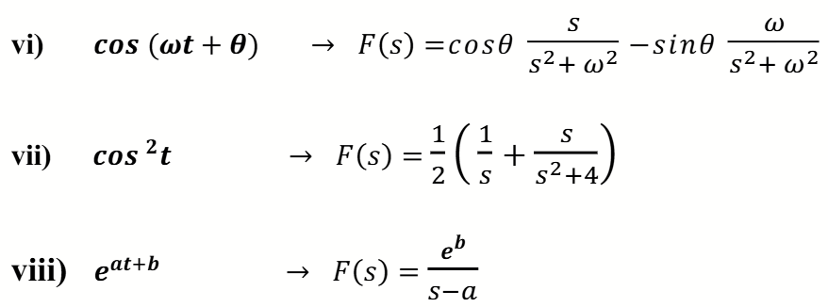
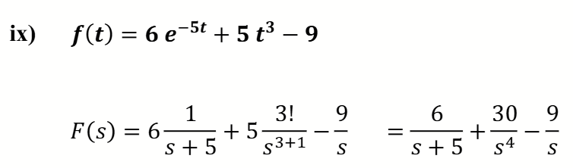

Slide 13
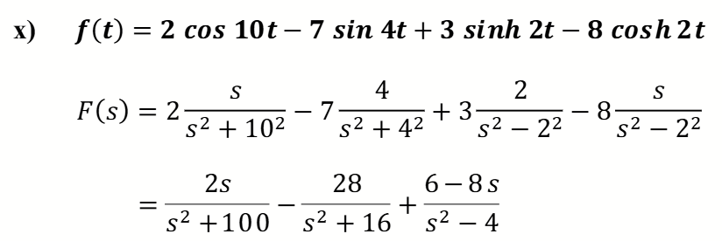
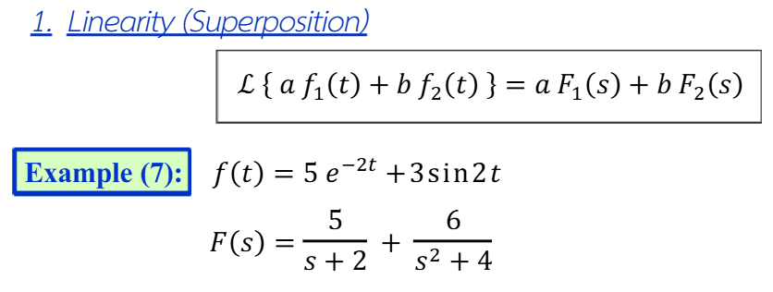
Module II: Some Properties of Laplace Transform and Related Examples

Slide 14
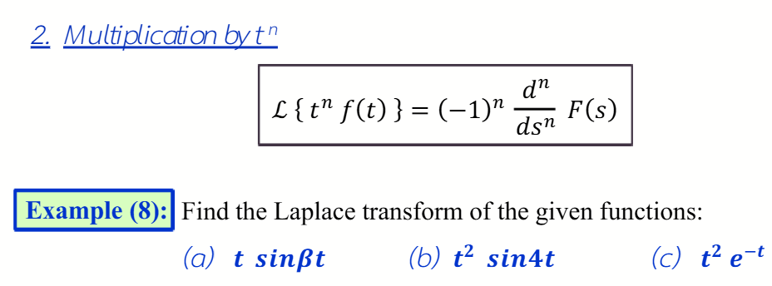
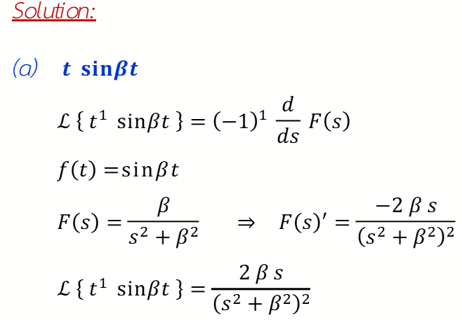

Slide 15
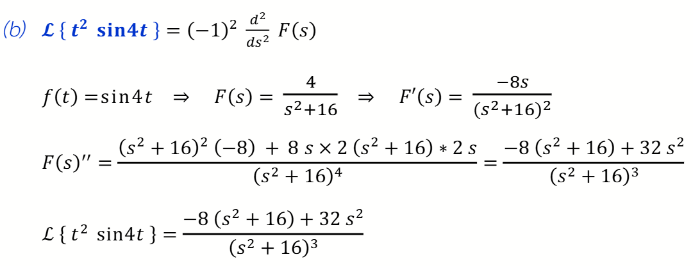
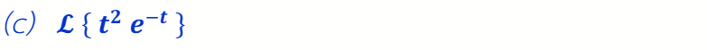

Do Yourself. Ans:

Slide 16
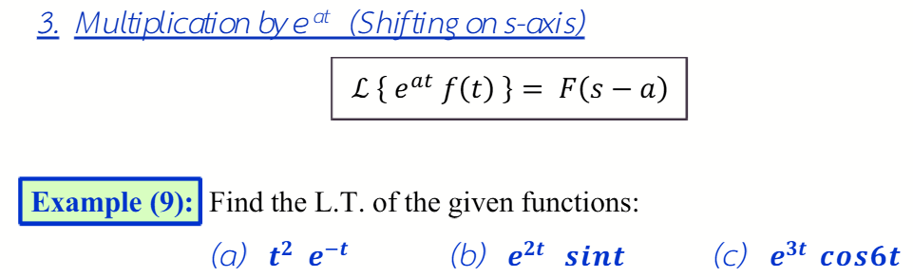
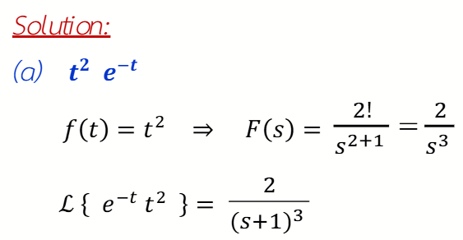

Slide 17
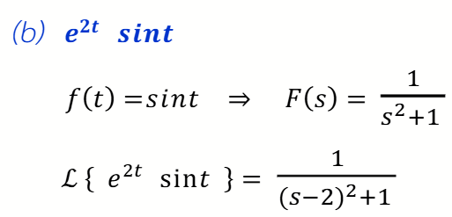


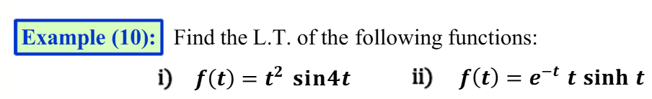
Do Yourself. Ans:

Slide 18
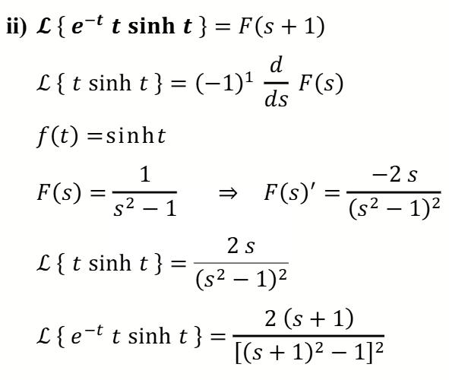

Slide 19
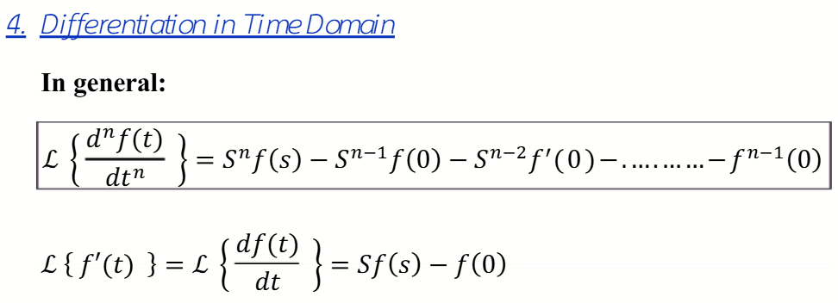
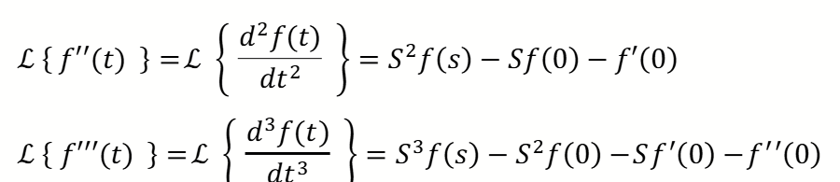

Slide 20
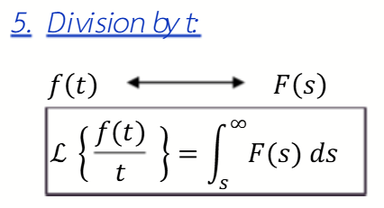
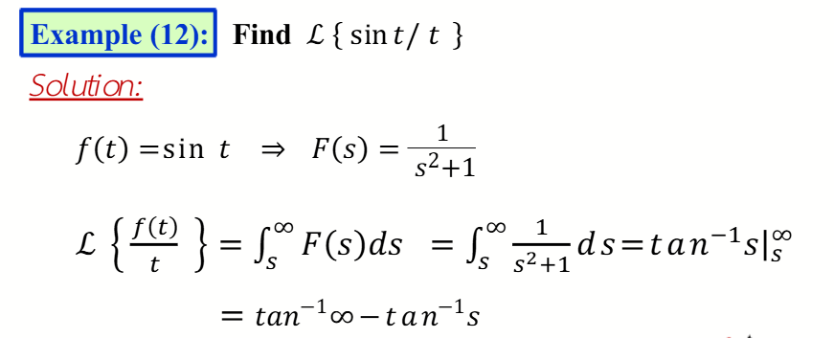

Slide 23
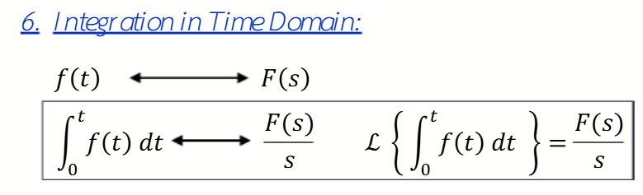
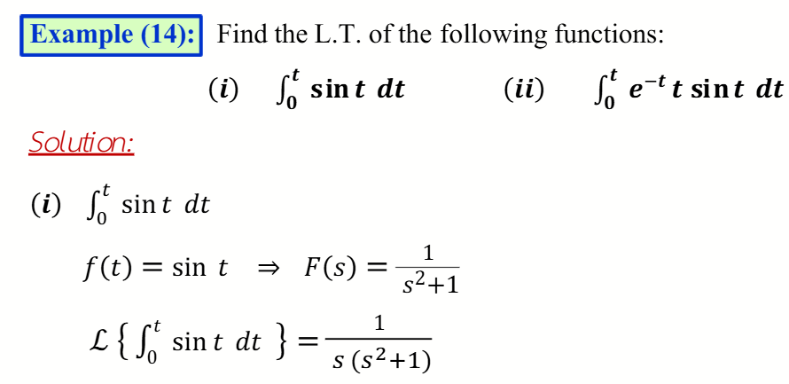
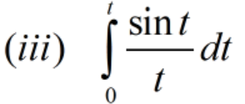

Slide 24
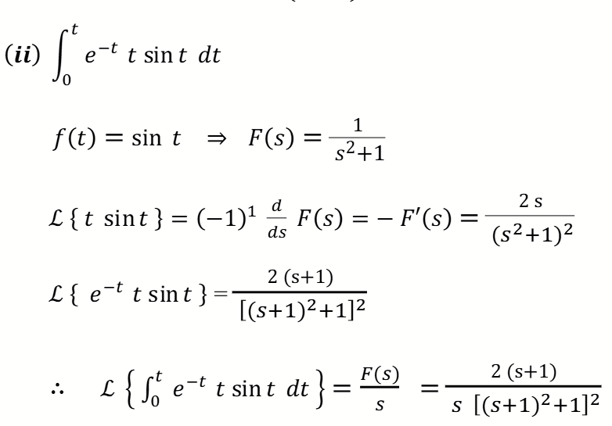

Slide 27
Do Yourself
Some Examples For Practice

Slide 28
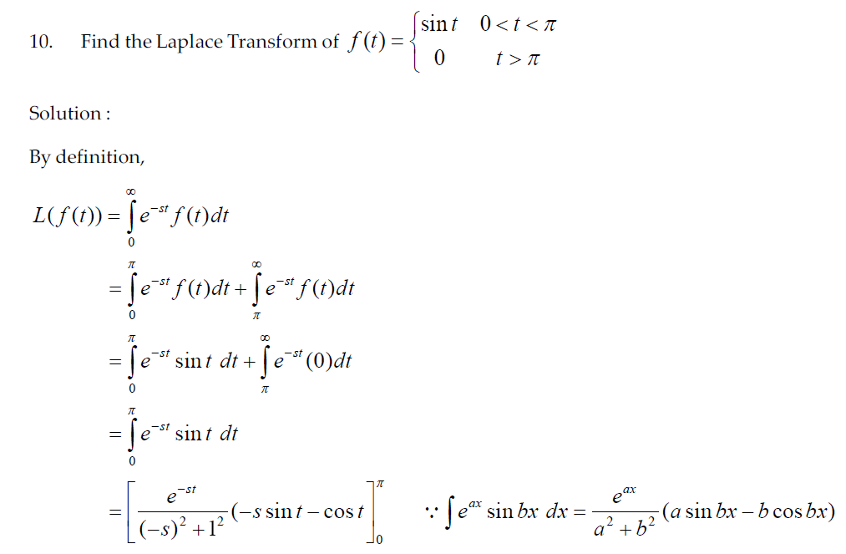
3.

Slide 29
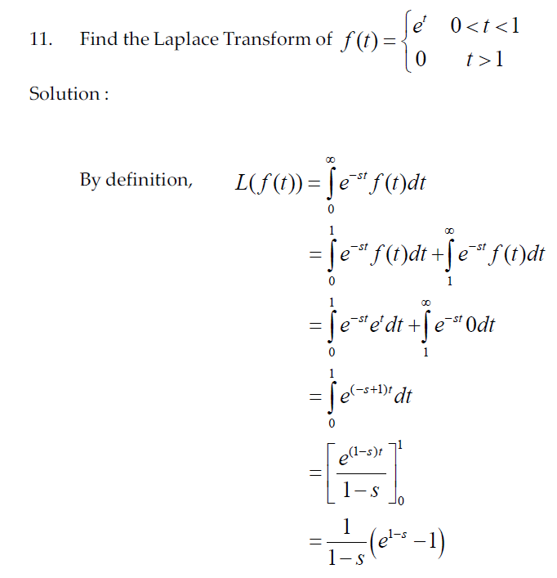
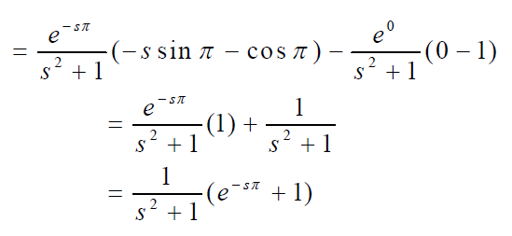
4.

